Slide 1


Classification: Fundamentals and Techniques
This presentation will provide a comprehensive overview of the classification problem, covering key algorithms, evaluation metrics, and real-world applications.
by Mentor

Slide 2
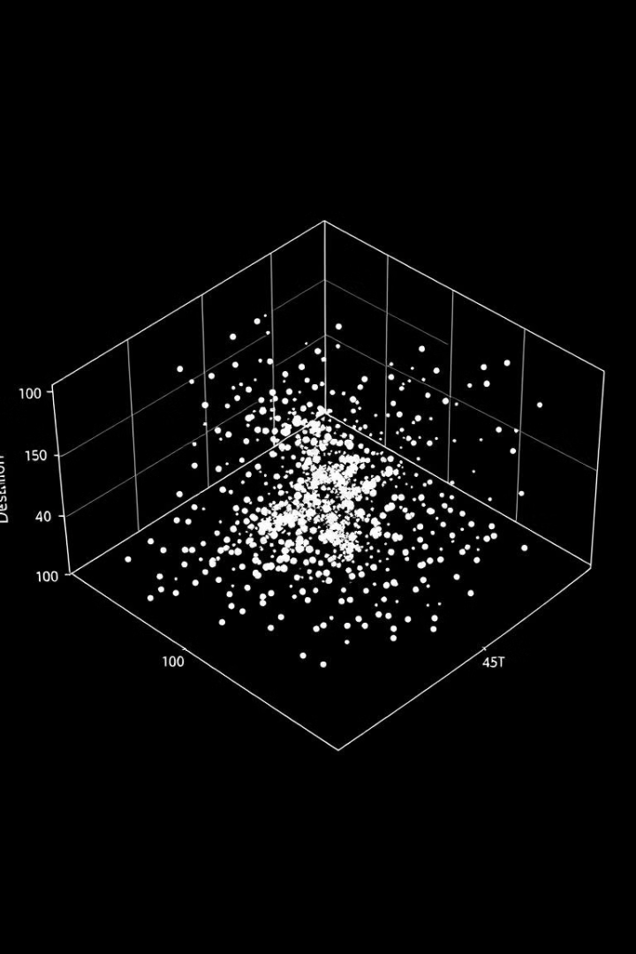
Understanding the Classification Problem
1
Predicting Class Labels
2
Supervised Learning
Classification algorithms learn to map input features to discrete output classes or categories.
Classification is a type of supervised learning, where the model is trained on labeled data.
3
Decision Boundaries
The goal is to learn optimal decision boundaries that separate different classes in the feature space.

Slide 3
Supervised Learning: Algorithms and Approaches
Linear Models
Tree-based Models
Kernel Methods
Logistic Regression, Linear Discriminant Analysis (LDA)
Decision Trees, Random Forests, Gradient Boosting
Support Vector Machines (SVMs)

Slide 4

Unsupervised Learning: Clustering Techniques
K-Means Clustering
Hierarchical Clustering
Partitions data into K clusters based on similarity of feature vectors.
Builds a hierarchy of clusters, useful for discovering natural groupings.
DBSCAN
Gaussian Mixture Models
Density-based clustering that can identify clusters of arbitrary shape and size.
Models data as a mixture of Gaussian distributions, useful for soft clustering.

Slide 5
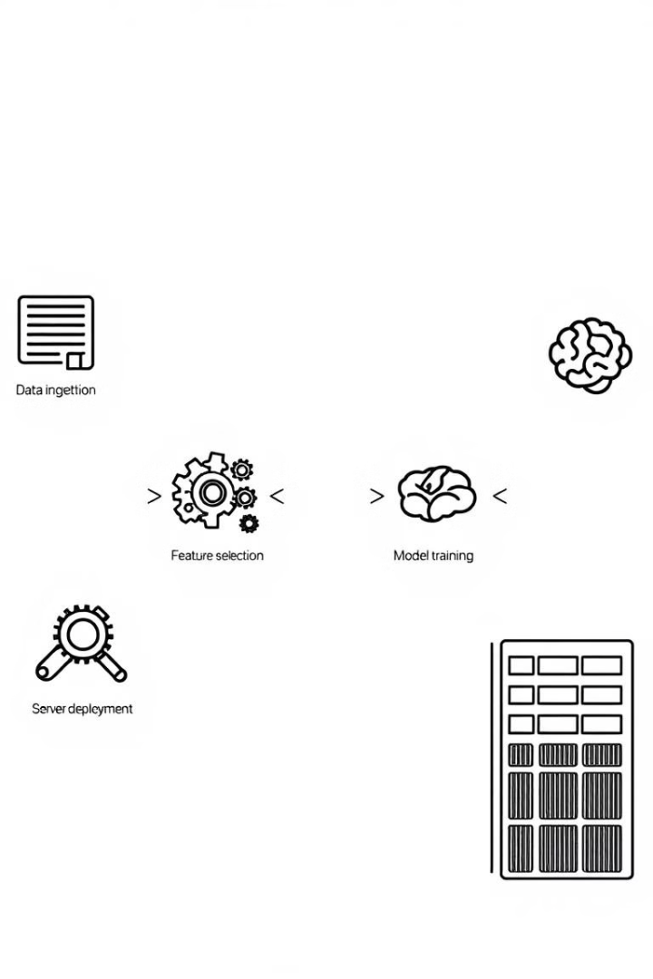
Feature Engineering and Selection
1
Data Preprocessing
Handling missing values, encoding categorical features, scaling numerical features.
2
Feature Creation
Deriving new features from existing ones to capture relevant information.
3
Feature Selection
Identifying the most informative features for the classification task.

Slide 6
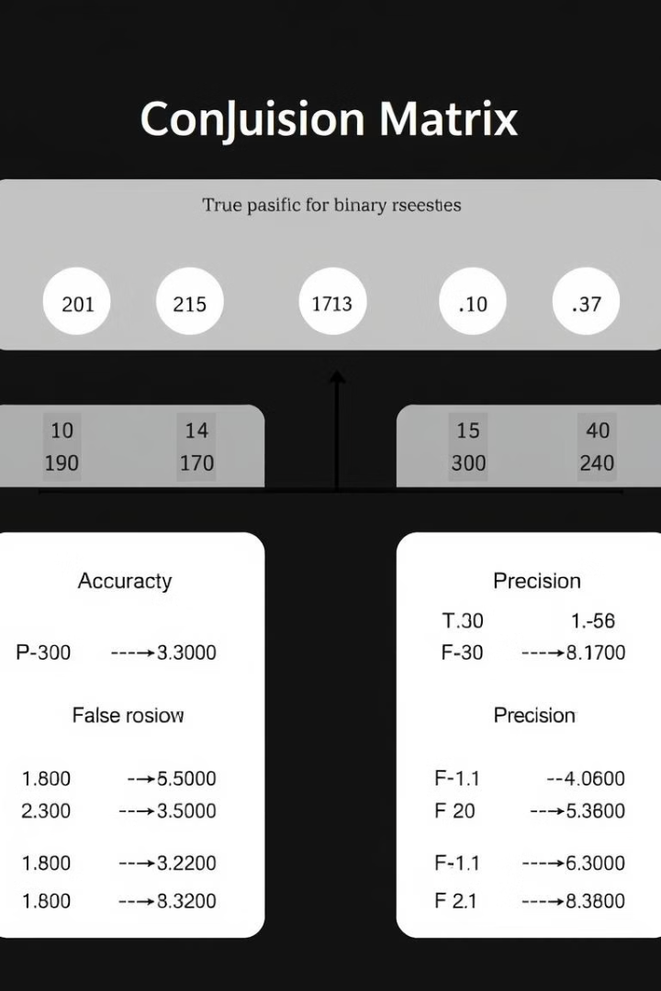




Model Evaluation Metrics
Accuracy
Precision
Overall correctness of the model's predictions.
Fraction of true positives among the predicted positives.
Recall
F1-Score
Fraction of true positives that are correctly identified.
Harmonic mean of precision and recall, balancing the two metrics.

Slide 7
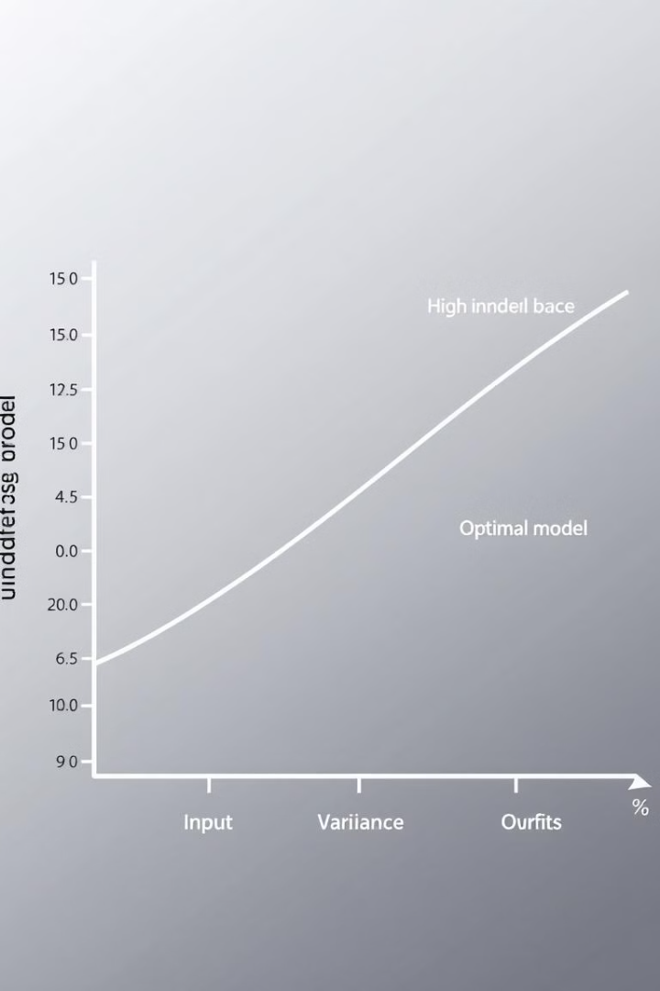



Overfitting and Underfitting
Underfitting
Model is too simple and fails to capture the underlying patterns in the data.
Optimal Fit
Model complexity is well-matched to the task, balancing bias and variance.
Overfitting
Model is too complex and memorizes the training data, performing poorly on new data.

Slide 8
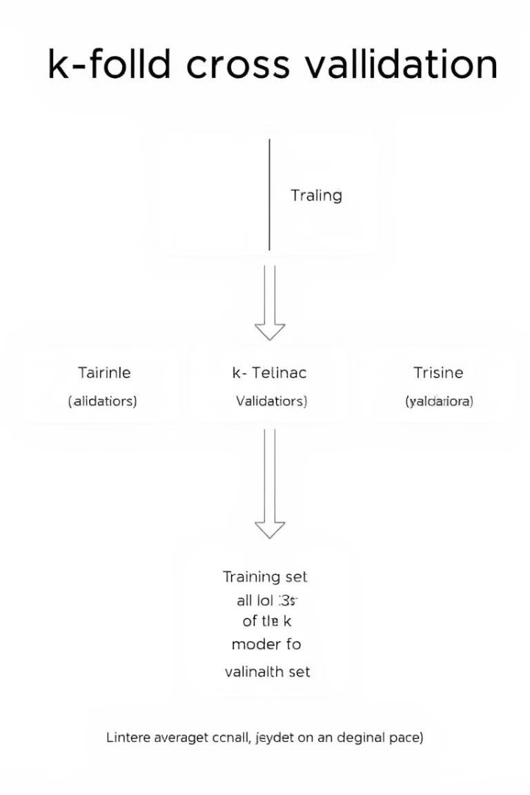
Cross-Validation Strategies
1
Holdout
Partition data into training and test sets, evaluate on the held-out test set.
2
K-Fold
Divide data into K folds, train on K-1 folds and validate on the remaining fold.
3
Stratified K-Fold
Ensure each fold has the same class distribution as the original dataset.

Slide 9
Imbalanced Datasets and Handling
Challenges
Techniques
Evaluation
Classification models tend to be biased towards the majority class, leading to poor performance on the minority class.
Oversampling the minority class, undersampling the majority class, or using class weights to balance the classes.
Use metrics like precision, recall, and F1-score instead of accuracy to assess model performance on imbalanced data.

Slide 10

Real-World Applications of Classification
Image Recognition
Spam Detection
Classify images of objects, animals, or scenes for applications like autonomous vehicles and photo organization.
Classify emails as spam or ham to protect users from unwanted and malicious content.
Medical Diagnosis
Credit Risk Assessment
Classify medical conditions based on patient symptoms, lab tests, and medical history.
Classify loan applicants as high or low risk to support financial decision-making.

